Slide 1

Economic Growth and Subjective Well-Being
Zack baker
Notes:
Hi everyone, my name is Zack Baker and my course project is on Economic Growth and Subjective Well-Being.

Slide 2

Definitions
•Gross Domestic Product (GDP): The total monetary or
market value of all the finished goods and services
produced within a country’s borders within a specific
time period
•Gross National Income (GNI): Total income received by
a country from its residents and businesses, regardless of the geographic location of the income
GNI per capita: Rough measure of average standard of living in a country
Notes:
First, I’ll start by defining a few terms I’ll use throughout this presentation. Some of you may be familiar with these, as they’re mostly the same as from my midterm presentation, but I just want to make sure we’re all on level ground before we get started.
Gross Domestic Product, or GDP, is defined as the total monetary or market value of all finished goods and services produced within a country’s borders in a specific time period. Typically this is measured annually. Economists use GDP as a comprehensive “scorecard” of a country’s overall economic health. As you might guess, if a country has a high level of GDP, we assume it’s doing fairly well, while a low level means it’s doing poorly.
Gross National Income, or GNI, is the total income received by a country from its residents and businesses, regardless of the geographic location of the income. So unlike GDP, income doesn’t have to be produced within the country’s borders to be counted in the GNI figure. GNI is the preferred measure of a country’s wealth in the field of international development, so I ended up using that measure in my project. However, GDP and GNI are approximately equal for most countries, so I may use them interchangeably in this presentation.
And lastly, GNI per capita is of course GNI divided by a country’s population, so we can see it as a rough measure of the average standard of living in a country.
Next, I’ll move into some of the background behind this project.

Slide 3
GDP as a Measure of Development
• GDP is easy to measure – single concrete measure of standard of living
Objective and comparable across countries
• GDP is an indicator of growth in jobs and income
• GDP is highly correlated with other factors important to human welfare:
Positively correlated with life expectancy, negatively correlated with infant mortality and inequality
Notes:
There’s a lot to like about GDP or GNI when we consider the context of economic development of countries around the world.
First, GDP is a single number that is pretty easy to measure. It’s an objective number that we can compute and then easily compare across countries.
Secondly, GDP is an indicator of the growth of jobs and income, which are obviously important in determining quality of life.
Then finally, GDP is highly correlated with other factors that are important to human welfare. In most countries, higher levels of GDP per capita occur hand-in-hand with other improvements to quality of life, such as higher levels of life expectancy, and lower levels of infant mortality and inequality.
Considering these factors, it’s not surprising that growing a country’s GDP is often seen as the best way to improve the quality of life of its citizens.

Slide 4
GDP as a Measure of Development
• GDP does not measure:
Leisure time
Levels of health, learning, environmental cleanliness, etc.
Inequality
Etc.
• Easterlin Paradox: Post-WWII economic growth had little effect on happiness levels
Notes:
For all that GDP can measure, there are a number of things that it cannot measure.
First, consider leisure time. The per capita GDP in the US is larger, say, than that of Germany, but this doesn’t mean that the US has a higher standard of living because the average American works many more hours per year than the average German.
Secondly, GDP can tell us how much was spent in a year on different factors, such as health, learning, and environmental cleanliness, for example, but it doesn’t tell us anything about the actual levels of health, learning, or environmental cleanliness within a country.
Next, with regard to inequality, GDP per capita can’t tell us anything, because it’s only an average. When GDP per capita rises by 5%, for example, it could mean that GDP for everyone in the country has risen by 5% or that the GDP of some groups has risen by more while that of others has risen by less—or even fallen.
Finally, we can’t necessarily be sure that economic growth makes people any happier at all. The famous economist Richard Easterlin did a number of studies looking at economic growth and happiness after the post-WWII economic boom in the US, and found that the rampant growth had very little effect on the overall happiness of US citizens.

Slide 5
Alternative Measures of Development
• Alternative measures of development:
Human Development Index (HDI): calculated using GNI per capita, life expectancy, and average years of schooling
Social Progress Index (SPI): Uses 54 different quality of life indicators
Gross National Happiness (GNH): Comprehensive framework with 9 domains, including psychological well-being, health, time use, education, and culture
• My project: explore the relationships between country development indicators and
“happiness scores” around the world
Notes:
The weaknesses of the GDP measure have led to the creation of a variety of alternative development measures that focus on increasing quality of life in a holistic way, taking a variety of factors into account.
One of the most popular alternative development measures is the Human Development Index, which was created by the United Nations in 1990. Like GDP, it is a single number meant to quantify the quality of life in a country. It is calculated using GNI per capita, life expectancy, and average years of schooling in a country.
The Social Progress Index, which was developed by a non-profit called the Social Progress Imperative, takes a different approach. They use 54 different quality of life indicators, including access to water and sanitation, education, health, housing, and communication. This is fairly complex, so it hasn’t been seen as being all that practical for informing policy decisions.
Lastly, Gross National Happiness, or GNH, is a framework developed by the country of Bhutan to better understand the well-being of its residents. Every 5 years, 8,000 residents of Bhutan are chosen to fill out a 300-question survey that includes questions from domains including psychological well-being, health, time use, education, and culture. The country’s leaders track this very closely and try to align policy decisions with increasing GNH.
In my project, which I see as sort of “being in conversation” with some of these alternative measures, I explore the relationships between country development indicators, including GNI and some of the other factors mentioned here, and “happiness scores” around the world (which I will get to in just a minute).

Slide 6
Data Set 1: World Development Indicators
• Published annually by the World Bank
• Contains over 1,400 annual indicators of economic development from every
country in the world
• Variables include:
Demographic – Population growth, fertility rates
Economic – GDP, household consumption, trade
Health – Life expectancy, mortality rates
Education – Literacy rates
• After removing missing values and handling multicollinearity, left with 88 indicators
Notes:
Next, I’ll move into the data I used in my project.
I used two different data sets for my analysis, the first of which is the World Development Indicators which I found on Kaggle. This is a dataset published annually by the World Bank and includes over 1,400 annual indicators of economic development from every country in the world.
The indicators include demographic variables, such as population growth and fertility rates; economic variables, such as GDP, household consumption, and trade amounts; health variables, like life expectancy and mortality rates; and education variables such as literacy rates. These variables serve as predictors in my model.
There were quite a few missing values in this dataset, because not all countries report on all of these measures. Also many of the variables were just different ways of measuring the same thing. So for instance, one variable was GNI per capita in US dollars, while another was GNI per capita for each country expressed in terms of its own currency. After removing the missing values and deleting the extra variables, I was left with 88 total indicators.

Slide 7

Data Set 2: World Happiness Report
Annual report produced by the United Nations since 2012
Ranks 158 countries by happiness levels and includes a “happiness score” from 0-10 for each country
Derived from the “Cantril Ladder” question from the Gallup World Poll
Notes:
My second data set is the World Happiness Report, which I also found on Kaggle. This dataset has been published annually by the United Nations since 2012.
The report ranks 158 countries around the world by their happiness levels and includes a “happiness score” from 0 to 10 for each country.
The happiness scores are derived from the “Cantril ladder” question on the Gallup World Poll, which asks respondents to think of a ladder with the best possible life for them being a 10 and the worst possible life being a 0 and to rate their current lives on that scale.
My interest in this analysis was on the 0 to 10 happiness scores and not so much on the overall rank of countries by happiness levels.

Slide 8
Research Questions
(1.) Which development indicators are most predictive of country happiness scores?
(2.) Do the contributions of different development indicators to happiness scores
vary between developed and developing countries?
(3.) Which observations are not fit well by the model, and why might this be?
(4.) Do the results point to potential policy measures that could enhance citizens’
well-being?
Notes:
My research questions were as follows:
1.) Which development indicators are most predictive of country happiness scores?
2.) Do the contributions of different development indicators to happiness scores vary between developed and developing countries?
3.) Which observations are not fit well by the model, and why might this be?
4.) Do the results point to potential policy measures that could enhance citizens’ well-being?

Slide 9
Estimation Strategy
• Approach: Use predictors from the World Development Indicators to predict
happiness scores
• Need variable selection and an interpretable model
• Techniques:
Lasso regression → L1 penalty, induce sparsity
Multiple linear regression with stepwise variable selection
Notes:
My overall approach to the analysis was to use the happiness scores as the response variable in my model, and then try to predict them using the variables from the World Development Indicators.
It was really important for me to use variable selection and form an interpretable model. As I showed, even after removing a number of variables there were still almost 90 potential predictors, and it wasn’t very clear to me from the outset which would be important in predicting happiness levels. So having a way to reduce the number of variables was essential.
As far as interpretability, I wanted to know which factors are most useful in determining happiness, so a black box model would not have been be very helpful to me.
To give a bit of a roadmap of the analysis: I began by using lasso regression to reduce the number of potential predictors. Lasso regression uses the sparsity-inducing L1 penalty, meaning some coefficients are set to zero and removed from the model. Lasso regression is known to perform well with correlated predictors, so it was helpful in determining which variables would be most important to include in the model.
Once the potential predictors were chosen by the lasso model, I used backward stepwise variable selection to make the final model selection. But we’ll get to more of that in a minute.

Slide 10
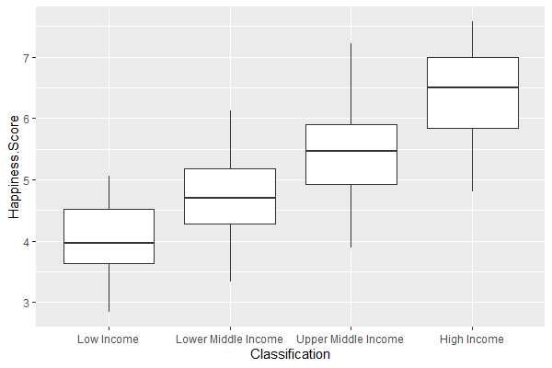
Exploratory Analysis
Notes:
Before moving into modeling the data, I did a little bit of exploratory analysis.
Here, I separated the countries in the data by their income classification: low income, lower middle income, upper middle income, and high income. Here, each boxplot corresponds to an income category and happiness scores are on the y-axis.
The trend here is pretty clear: residents of high-income countries are happier on average than residents of low-income countries. This is probably not all that surprising.

Slide 11

Exploratory Analysis
Most Happy Countries
Rank | Country | Classification | GNI Per Capita (2015)
1 | Switzerland | High Income | $85,800
2 | Iceland | High Income | $50,160
3 | Denmark | High Income | $60,510
4 | Norway | High Income | $93,110
5 | Canada | High Income | $47,570
Least Happy Countries
Rank | Country | Classification | GNI Per Capita (2015)
154 | Rwanda | Low Income | $750
155 | Benin | Lower Middle Income | $1,180
156 | Syria | Low Income | $681
157 | Burundi | Low Income | $260
158 | Togo | Low Income | $640
Notes:
We see a similar trend when we look at the most and least happy countries. The happiest countries are Switzerland, Iceland, Denmark, Norway, and Canada, which are all high-income countries with GNI per capita values greater than $40,000 per year.
**CLICK** The least happy countries are Rwanda, Benin, Syria, Burundi, and Togo. They are all low- or lower middle-income countries, and some of those GNI per capita values are pretty startling, with Burundi’s in particular being below a dollar a day.
Other interesting findings here were than the US was ranked 16th, and Bhutan, who started the Gross National Happiness measure I mentioned earlier, was ranked 80th.
But clearly, **CLICK** we see an association between GNI values and happiness.

Slide 12
Lasso Regression – Initial Predictors
Variable Name | Definition
GNI_Per_Capita | GNI per capita (current US$)
Gov_Ed_Spending | Total government expenditure on education (% of GDP)
Internet_Use | Individuals using the Internet (% of population)
Life_Exp | Life expectancy at birth (years)
Nurses_Midwives | Nurses and midwives (per 1,000 people)
Air_Pollution | PM2.5 air pollution, mean annual exposure (micrograms per cubic meter)
Pop_Growth | Population growth (annual %)
Urban_Pop | Urban population (% of total population)
Notes:
So after doing a little bit of exploration, I ran the lasso regression model with all 88 indicators as predictors to narrow down the list of candidate variables for the final model. I ended up with 8 candidate variables.
My initial predictors are GNI per capita, government expenditure on education, the percentage of population using the internet, life expectancy, the number of nurses and midwives per 1,000 people, the amount of air pollution, the population growth rate, and the percentage of the population living in urban areas. All of the other variables dropped out of the model.

Slide 13
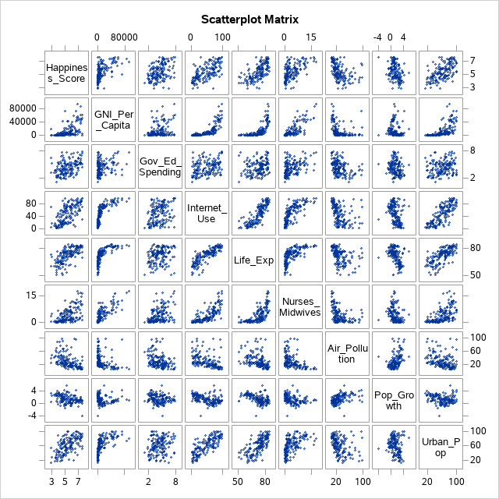
Variable Transformation
Notes:
Next, I took a look at the scatterplot matrix to see if any of the variables clearly needed transformation before moving forward. The one that clearly jumps out at me here is GNI per capita. **CLICK** It doesn’t look like it has a linear relationship with the happiness score.

Slide 14
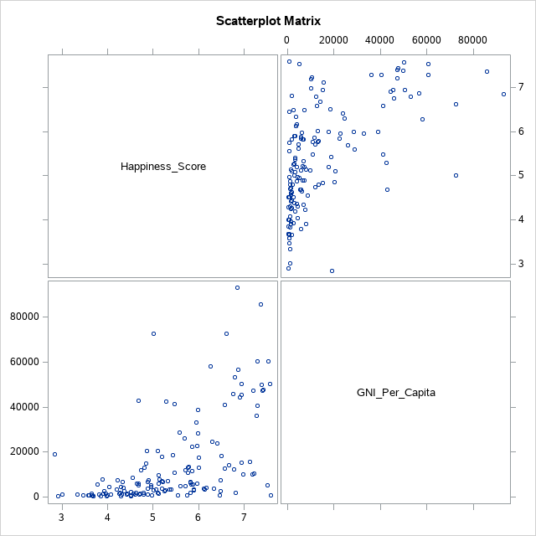
Variable Transformation: Before
Notes:
Sure enough, this looks problematic as we take a closer look. The power transformation function recommended a square root transformation, so I did that and obtained the scatterplot on the next slide.

Slide 15
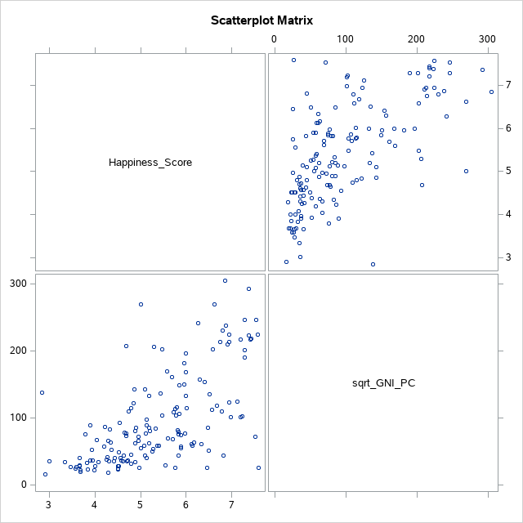
Variable Transformation: After
Notes:
And we see here that the relationship looks much more linear, so I proceed with the square root transformation.

Slide 16

Interaction Terms
• Might the impact of economic variables on happiness depend on income?
Indicator variable: High_Income = 1 if GNI_Per_Capita > $12,375
= 0 otherwise
Potential interactions:
(1) High_Income*GNI_Per_Capita
(2) High_Income*Pop_Growth
Notes:
One of my research questions is whether the impact of different economic indicators on happiness varies between developed and developing countries. So before fitting my initial model, I created an indicator variable called “High Income” that equals 1 if the country’s GNI per capita is greater than $12,375 per year, which is how the World Bank classifies a high-income country, and 0 otherwise.
I’m interested in two possible interactions here. First, we might think that the impact of GNI per capita on happiness may depend on income level. When a country has a high GNI per capita, adding a dollar or two to that may not have much impact on happiness, while at lower levels of GNI, a few dollars might make a pretty substantial difference.
Secondly, we may think that the impact of population growth on happiness may also depend on income level. Richer countries likely have the resources to handle a growing population without much issue, whereas population growth in poorer countries might put a lot of strain on the available resources of the country.
So my initial model includes these interactions.

Slide 17
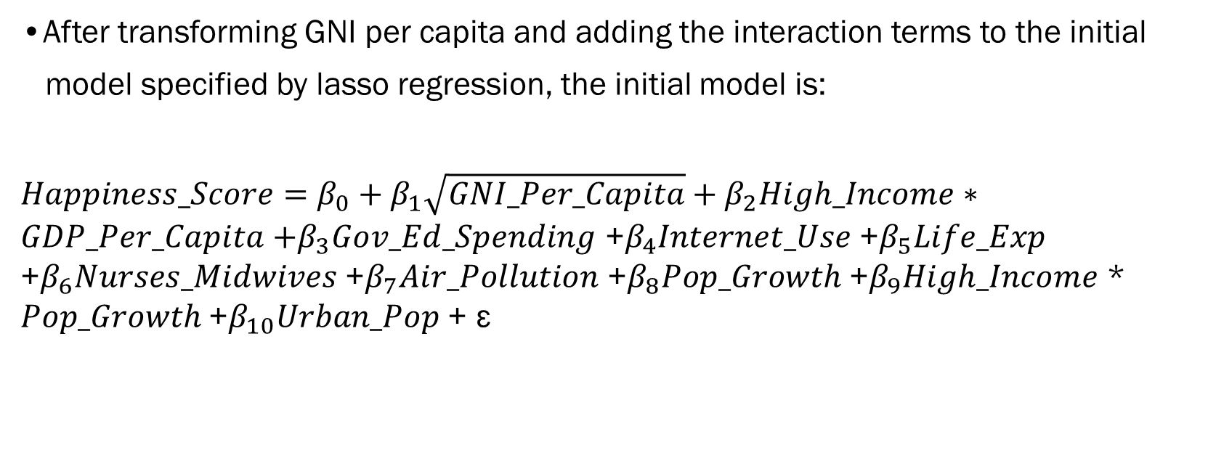
Initial Model
•After transforming GNI per capita and adding the interaction terms to the initial
model specified by lasso regression, the initial model is:
$Happiness_Score=β_{0}+β_{1}\sqrt{GNI_Per_Capita}+β_{2}High_Income∗GDP_Per_Capita$ $+β_{3}Gov_Ed_Spending$ +$β_{4}Internet_Use$ +$β_{5}Life_Exp$ +$β_{6}Nurses_Midwives$ +$β_{7}Air_Pollution$ +$β_{8}Pop_Growth$ +$β_{9}High_Income$ * $Pop_Growth$+$β_{10}Urban_Pop$ + ε
Notes:
My initial model has happiness score as the response and uses all of the predictors specified by the lasso regression model plus the interaction terms just mentioned. This will be my baseline model. We can see here that there are 10 predictors in this first model.

Slide 18




Initial Model Results
Final Model
Coefficients | Estimate | Std. Error | t-value | Pr(>|t|) | VIF
Intercept | 1.51260 | 1.11814 | 1.35 | 0.1783 | 0
sqrt(GNI_Per_Capita) | 0.00460 | 0.00441 | 1.04 | 0.2983 | 22.39125
High_Income*GNI_Per_Capita | -0.00186 | 0.00249 | -0.75 | 0.4572 | 12.09988
Gov_Ed_Spending | 0.15036 | 0.05009 | 3.00 | 0.0032 *** | 1.27552
Internet_Use | -0.00322 | 0.00596 | -0.54 | 0.5894 | 6.73304
Life_Exp | 0.03721 | 0.01633 | 2.28 | 0.0241 ** | 3.99273
Nurses_Midwives | 0.02071 | 0.03021 | 0.69 | 0.4942 | 3.62234
Air_Pollution | -0.00437 | 0.00419 | -1.04 | 0.2989 | 1.68676
Pop_Growth | -0.13639 | 0.07323 | -1.86 | 0.0646 * | 2.18355
High_Income*Pop_Growth | 0.15786 | 0.12368 | 1.28 | 0.2039 | 2.54585
Urban_Pop | 0.00872 | 0.00519 | 1.68 | 0.0956 * | 3.15581
 | RSE | 0.80347
 | R-Squared | 0.5499
Coefficients | Estimate | Std. Error | t-value | Pr(>|t|) | VIF
Intercept | 1.51260 | 1.11814 | 1.35 | 0.1783 | 0
sqrt(GNI_Per_Capita) | 0.00460 | 0.00441 | 1.04 | 0.2983 | 22.39125
High_Income*GNI_Per_Capita | -0.00186 | 0.00249 | -0.75 | 0.4572 | 12.09988
Gov_Ed_Spending | 0.15036 | 0.05009 | 3.00 | 0.0032 *** | 1.27552
Internet_Use | -0.00322 | 0.00596 | -0.54 | 0.5894 | 6.73304
Life_Exp | 0.03721 | 0.01633 | 2.28 | 0.0241 ** | 3.99273
Nurses_Midwives | 0.02071 | 0.03021 | 0.69 | 0.4942 | 3.62234
Air_Pollution | -0.00437 | 0.00419 | -1.04 | 0.2989 | 1.68676
Pop_Growth | -0.13639 | 0.07323 | -1.86 | 0.0646 * | 2.18355
High_Income*Pop_Growth | 0.15786 | 0.12368 | 1.28 | 0.2039 | 2.54585
Urban_Pop | 0.00872 | 0.00519 | 1.68 | 0.0956 * | 3.15581
 | RSE | 0.80347
 | R-Squared | 0.5499
Coefficients | Estimate | Std. Error | t-value | Pr(>|t|) | VIF
Intercept | 1.51260 | 1.11814 | 1.35 | 0.1783 | 0
sqrt(GNI_Per_Capita) | 0.00460 | 0.00441 | 1.04 | 0.2983 | 22.39125
High_Income*GNI_Per_Capita | -0.00186 | 0.00249 | -0.75 | 0.4572 | 12.09988
Gov_Ed_Spending | 0.15036 | 0.05009 | 3.00 | 0.0032 *** | 1.27552
Internet_Use | -0.00322 | 0.00596 | -0.54 | 0.5894 | 6.73304
Life_Exp | 0.03721 | 0.01633 | 2.28 | 0.0241 ** | 3.99273
Nurses_Midwives | 0.02071 | 0.03021 | 0.69 | 0.4942 | 3.62234
Air_Pollution | -0.00437 | 0.00419 | -1.04 | 0.2989 | 1.68676
Pop_Growth | -0.13639 | 0.07323 | -1.86 | 0.0646 * | 2.18355
High_Income*Pop_Growth | 0.15786 | 0.12368 | 1.28 | 0.2039 | 2.54585
Urban_Pop | 0.00872 | 0.00519 | 1.68 | 0.0956 * | 3.15581
 | RSE | 0.80347
 | R-Squared | 0.5499
Notes:
Now we turn to the results from the initial model. We see that the majority of the coefficient estimates are not significant, but **CLICK** government spending on education, life expectancy, population growth, and the percentage of people living in urban areas are all statistically significant. These variables all have their expected signs, as we expect that **CLICK** greater spending on education, longer life expectancies, and higher levels of urbanization **CLICK** should be associated with higher happiness scores, while **CLICK** population growth might decrease happiness.
The fact that many of these coefficients are insignificant **CLICK** makes me wonder if some of these variables are correlated. Generally we think of a variance inflation factor above about 5 as being problematic, and we see **CLICK** 3 estimates with VIF values above 5 here. Also **CLICK** the R-squared value is about 0.55. All of this makes me think that we might be able to remove some of the variables here to reduce the multicollinearity and end up with a better model.
So next **CLICK** I turn to backward stepwise variable selection to choose a new, final model using the predictors from this initial model fit. **CLICK**

Slide 19
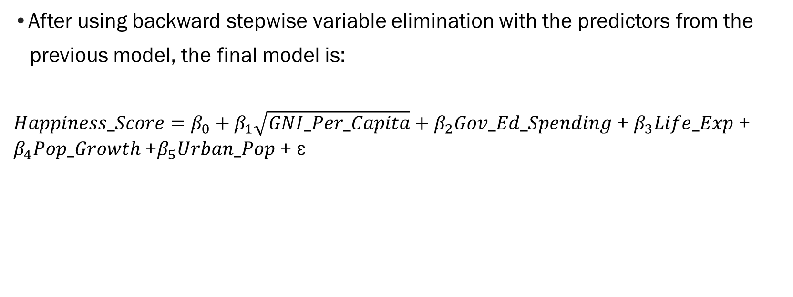
Final Model
•After using backward stepwise variable elimination with the predictors from the
previous model, the final model is:
$Happiness_Score=β_{0}+β_{1}\sqrt{GNI_Per_Capita}+β_{2}Gov_Ed_Spending$ + $β_{3}Life_Exp$ + $β_{4}Pop_Growth$+$β_{5}Urban_Pop$ + ε
Notes:
After using backward stepwise elimination, the model goes from 10 predictors to only 5! Those are the square root of GNI per capita, government educational spending, life expectancy, population growth, and urban population. Interestingly, both of the two interaction terms I specified had very high p-values and were removed from the final model.

Slide 20

Final Model Results
Coefficients | Estimate | Std. Error | T-value | Pr(>|t|) | VIF
Intercept | 1.01008 | 0.98339 | 1.03 | 0.3060 | 0
sqrt(GNI_Per_Capita) | 0.00334 | 0.00166 | 2.01 | 0.0461 ** | 3.21942
Gov_Ed_Spending | 0.16770 | 0.04625 | 3.63 | 0.0004 *** | 1.10096
Life_Exp | 0.04018 | 0.01482 | 2.71 | 0.0075 *** | 3.33095
Pop_Growth | -0.10567 | 0.05674 | -1.86 | 0.0645 * | 1.32704
Urban_Pop | 0.00916 | 0.00451 | 2.03 | 0.0438 ** | 2.40374
 | RSE | 0.79848
 | R-Squared | 0.5398
Coefficients | Estimate | Std. Error | T-value | Pr(>|t|) | VIF
Intercept | 1.01008 | 0.98339 | 1.03 | 0.3060 | 0
sqrt(GNI_Per_Capita) | 0.00334 | 0.00166 | 2.01 | 0.0461 ** | 3.21942
Gov_Ed_Spending | 0.16770 | 0.04625 | 3.63 | 0.0004 *** | 1.10096
Life_Exp | 0.04018 | 0.01482 | 2.71 | 0.0075 *** | 3.33095
Pop_Growth | -0.10567 | 0.05674 | -1.86 | 0.0645 * | 1.32704
Urban_Pop | 0.00916 | 0.00451 | 2.03 | 0.0438 ** | 2.40374
 | RSE | 0.79848
 | R-Squared | 0.5398
Notes:
Here are the final model results. All of the variables are statistically significant at the 10% level, and population growth is the only one that isn’t significant at 5%. Again, the variables in the model have exactly the signs we expect. **CLICK** Increasing GNI per capita, government educational spending, life expectancy, and urban population should all be **CLICK** associated with higher happiness scores, while **CLICK** population growth should lead to a decrease in overall happiness because of the added strain on resources and infrastructure. **CLICK x 2** We see that the variance inflation factors here are much smaller than those from the initial model, so removing some of the predictors seems to have reduced the correlation between variables in the model. And sure enough, **CLICK** R-squared only fell by about 1% (to about 0.54) from the initial model despite us removing 5 variables!

Slide 21
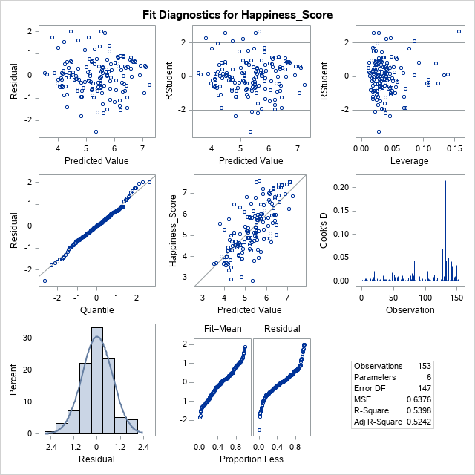
Model Diagnostics
Notes:
We can take a quick look at a few of the diagnostic plots reported by SAS for the final model. *CLICK* Looking at both the residual vs. fitted and the standardized residual vs. fitted plots in the upper left, it looks like the residuals are fairly evenly scattered around the plot which is a good sign. *CLICK* Going down the left hand side here, the qqplot of the residuals looks like it tracks the normal line pretty well. And then the residual histogram in the bottom left looks pretty even, so no worries there.
*CLICK* The only thing that concerned me was the Cook’s distance plot here on the right hand side. It looks like there is one point that has a much larger Cook’s distance than the rest *CLICK*. I looked into this further and it turns out this is Switzerland, which happens to be the happiest country in the world according to the data. It has a happiness score that’s much larger than predicted by the model. Though I won’t show it here, I removed Switzerland and re-ran the stepwise model and not much changed. The same variables were still selected and each of the p-values changed only slightly. So in the end I opted to keep it in the data set.
But overall, things look pretty good and I’m pretty happy with these diagnostics.

Slide 22
Comparison with Human Development Index (HDI)
MY MODEL
HDI MODEL
HEALTH
Life Expectancy
Life Expectancy
STANDARD OF LIVING
GNI per capita
GNI per capita
EDUCATION
Govt. Spending on Edu
Expected Years of Schooling
POPULATION
Mean Years of Schooling
Population Growth
Percent Urban Population
Notes:
After creating my final model, I wanted to compare it to the development model that’s most similar to mine, which is the Human Development Index (HDI). The HDI quantifies each country’s development by computing a score from 3 dimensions, which are health, standard of living, and education.
The indicators for the HDI model are shown here in orange**CLICK**, while the indicators from my model are shown in brown **CLICK**.
Honestly, I was pretty surprised when I realized how similar my model was to the HDI. Both my model and the HDI use life expectancy to quantify health and GNI per capita to capture standard of living. Both my model and the HDI model capture the impact of education, though through different measures. The HDI factors in the mean and expected years of schooling for people in a country, whereas I capture the education effect by the amount of government spending on education.
One difference is that my model captures the impact of overall population trends on happiness while the HDI does not. This makes sense, as the HDI really seeks to capture the experience of an individual within a culture or country, whereas my model takes some demographic trends into account that are outside of the individual and capture the population as a whole.
It’s also important to note that my model and the HDI model don’t necessarily claim to capture the same thing. The HDI scores are meant to model human development, whereas my model seeks to understand human happiness. I think the similarities between these two measures show us that these two things are very tightly interwoven.

Slide 23
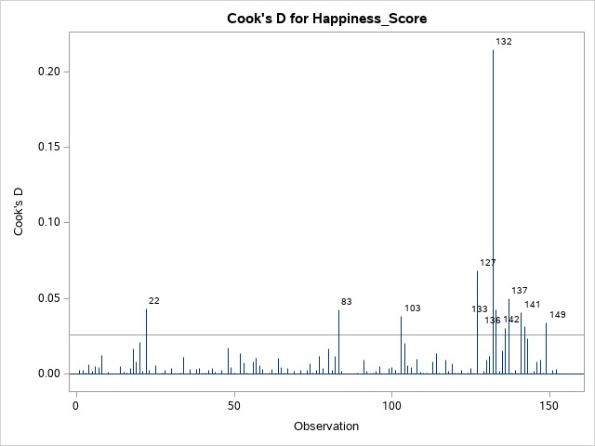
Outliers and Influential Points
Country | Happiness Score | Predicted Happiness Score
Switzerland | 7.59 | 5.66
Syria | 3.01 | 4.82
Venezuela | 6.81 | 5.07
Notes:
Next, we can take a look at some of the outliers and influential points from the final model, as this can often help us to see the weaknesses or drawbacks of the model.
Observation 132, the one with the large Cook’s distance here, is Switzerland (as I showed a few slides ago). Switzerland is much happier than predicted! It has a predicted happiness score of 5.66, and an actual score of 7.59, making it the happiest country in the data set. Switzerland does a lot of things well: They have a large GDP per capita, long life expectancy, they work only about 35 hours per week on average, have a beautiful natural environment, great healthcare system, good government, and more. They really are an outlier in the world when it comes to a lot of these things. But as far as my model goes, Switzerland points out a drawback to having such a simple model with only a handful of predictors. It isn’t able to really capture the intricacies of things like good governance and natural beauty, for instance.
Next we have Syria, which is observation 133 and has the second-highest Cook’s distance. Syria is much less happy than predicted by the model, and is one of the most unhappy countries overall. As some of you may have guessed, this can likely be attributed to the civil war the country has been engaged in since 2011. Huge numbers of people have been displaced through that conflict, including more than 4 million refugees that have fled to neighboring countries. So I’m not at all surprised that Syria is an outlier here, as the model doesn’t take this kind of domestic conflict into account.
Lastly we have Venezuela, which is observation 149 in the data. Venezuela is an interesting case. It’s known for having a deeply-ingrained culture of happiness, and its people are known for being pretty cheerful and upbeat. They even have a national office for happiness. However, Venezuela has been facing a number of problems for a few years now, from incredible inflation and unemployment to a president that’s basically a dictator at this point. So I was a little surprised to see that Venezuelans were a bit happier than predicted. So I took a look at some more recent editions of the World Happiness Report, and it turns out Venezuela fell from ranked 5th in the world in 2012 to 102nd by 2018. So probably shortly after my data was collected (in 2015) some of the problems they’ve been facing finally caught up to them. So clearly a lot of this happiness research depends on timing!

Slide 24
Takeaways
(1) We can model human happiness across countries using just a handful of economic
development indicators
Health, income, education, and overall population trends are the best predictors
(2) Contributions of different factors to happiness levels do not seem to vary between
developed and developing countries
(3) Policy aimed at increasing happiness may focus on the domains deemed significant
in the model
Don’t oversimplify!
Notes:
Lastly, I’ll provide a few takeaways from this analysis, mostly relating to my initial research questions.
First, **CLICK x2** we can model human happiness across countries using just a handful of economic development indicators. This is exciting! As we’ve seen, health, income, education, and overall population trends seem to be the best predictors of happiness. As we saw, these are the same predictors used to model human development, so clearly there’s a relationship between human happiness and the level of economic development in a country.
Secondly, **CLICK** the contributions of these different factors to happiness levels do not seem to vary much between developed and developing countries. I tried to use an interaction term to see if the contributions of both GNI per capita and population growth to happiness varied between high and low-income countries, and neither seemed to be significant. Further study might be done to see if there are other variables that might have a significant interaction with income.
Finally, **CLICK** my last research question focused on policy options to increase the happiness of citizens. Certainly we see that devoting more resources to health and education, as well as increasing economic opportunities for residents are fruitful policy options, probably unsurprisingly to most of us. But perhaps more importantly, this analysis shows us that many of these economic variables are highly correlated and the relationships between them can be fairly complex. So leaders should be cautious and think about these relationships rather than just try to improve the value of a single indicator. For instance, we see that increasing the percentage of people living in urban areas seems to increase happiness. But in some low-income countries, there aren’t enough resources to sustain large urban populations, so a policy designed to increase urbanization should take this into account. So just because I happened to come up with a simple model doesn’t mean that happiness is a simple problem with an easy solution.

Slide 25
References
https://www.npr.org/sections/parallels/2018/02/12/584481047/the-birthplace-of-gross-national-happiness-is-growing-a-bit-cynical
https://www.khanacademy.org/economics-finance-domain/macroeconomics/macro-economic-indicators-and-the-business-cycle/macro-limitations-of-gdp/a/how-well-gdp-measures-the-well-being-of-society-cnx
https://www.theigc.org/blog/is-gdp-an-adequate-measure-of-development/
https://hbr.org/2016/04/when-economic-growth-doesnt-make-countries-happier
https://qz.com/1267005/venezuelas-crisis-has-made-it-one-of-the-unhappiest-countries-in-the-world/
https://www.telegraph.co.uk/travel/destinations/europe/switzerland/articles/Why-is-Switzerland-so-happy/
https://www.businessinsider.com/the-unhappiest-country-in-the-world-is-syria-2015-11

Slide 26
Thank You!
Notes:
Thank you!

